Slide 1

UNIT-II
Variables and Operators

Slide 2
Topics covered
Variables and Operators:
Understanding Python variables, (covered in UNIT I- part 2 ppts)
multiple variable declarations, (covered in UNIT I- part 2 ppts)
Operators in Python:
Arithmetic operators,
Assignment operators,
Relational Operators,
Logical operators / Boolean Operators,
Bitwise operators,
Membership operators,
Identity operators,
Operator Precedence and Associativity,
Output statements, Input Statements and
Command Line Arguments.

Slide 3
Operators
Operators are special symbols in Python that carry out arithmetic or logical computation.
The value that the operator operates on is called the operand.
Python language supports the following types of operators-
Arithmetic Operators
Comparison (Relational) Operators
Assignment Operators
Logical Operators
Bitwise Operators
Boolean Operators,
Membership Operators
Identity Operators

Slide 4
Arithmetic Operators
Arithmetic operators are used to perform mathematical operations like addition, subtraction, multiplication, etc.
Operator | Meaning | Example
+ | Add two operands or unary plus | x + y
- | Subtract right operand from the left or unary minus | x - y
* | Multiply two operands | x * y
/ | Divide left operand by the right one (always results into float) | x / y
% | Modulus - remainder of the division of left operand by the right | x % y (remainder of x/y)
// | Floor division - division that results into whole number adjusted to the left in the number line | x // y
** | Exponent - left operand raised to the power of right | x**y (x to the power y)

Slide 5
Arithmetic Operators
Example:
x = 15
y = 4
# Output: x + y = 19
print('x + y =',x+y)
# Output: x - y = 11
print('x - y =',x-y)
# Output: x * y = 60
print('x * y =',x*y)
# Output: x / y = 3.75
print('x / y =',x/y)
# Output: x // y = 3
print('x // y =',x//y)
# Output: x ** y = 50625
print('x ** y =',x**y)

Slide 6
Comparison (Relational) Operators
Relational operators are used to compare values.
It returns either True or False according to the condition.
Operator | Meaning | Example
> | Greater than - True if left operand is greater than the right | x > y
< | Less than - True if left operand is less than the right | x < y
== | Equal to - True if both operands are equal | x == y
!= | Not equal to - True if operands are not equal | x != y
>= | Greater than or equal to - True if left operand is greater than or equal to the right | x >= y
<= | Less than or equal to - True if left operand is less than or equal to the right | x <= y

Slide 7
Logical / Boolean Operators
Logical operators are the and, or, not operators
x = True
y = False
print('x and y is',x and y)
print('x or y is',x or y)
print('not x is',not x)
Operator | Meaning | Example
and | True if both the operands are true | x and y
or | True if either of the operands is true | x or y
not | True if operand is false (complements the operand) | not x
Output:
x and y is False
x or y is True
not x is False

Slide 8
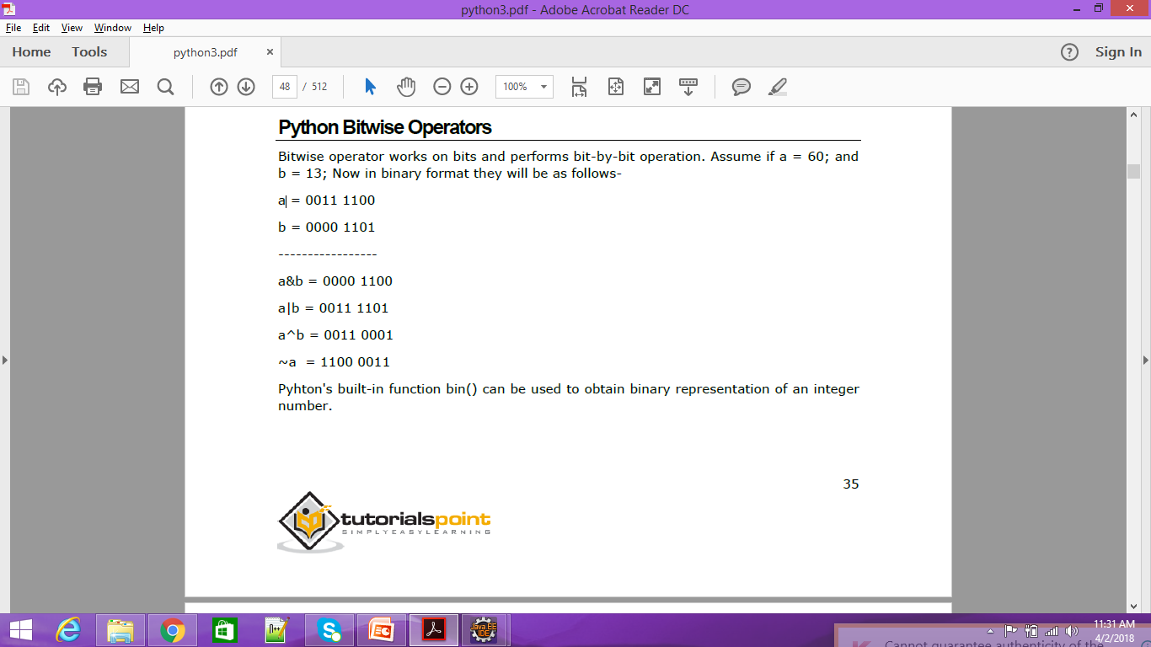
Bitwise Operators
Bitwise operators act on operands as if they were strings of binary digits.
They operate bit by bit, hence the name.
Operator | Meaning | Example
& | Bitwise AND | x & y
| | Bitwise OR | x | y
~ | Bitwise NOT | ~x
^ | Bitwise XOR | x ^ y
>> | Bitwise right shift | x >> 2
<< | Bitwise left shift | x << 2

Slide 9
Assignment Operators
Operator | Example | Equivalent to
= | x = 5 | x = 5
+= | x += 5 | x = x + 5
-= | x -= 5 | x = x - 5
*= | x *= 5 | x = x * 5
/= | x /= 5 | x = x / 5
%= | x %= 5 | x = x % 5
//= | x //= 5 | x = x // 5
**= | x **= 5 | x = x ** 5
&= | x &= 5 | x = x & 5
|= | x |= 5 | x = x | 5
^= | x ^= 5 | x = x ^ 5
>>= | x >>= 5 | x = x >> 5
<<= | x <<= 5 | x = x << 5
Assignment operators are used in Python to assign values to variables.
a = 5 is a simple assignment operator that assigns the value 5 on the right to the variable a on the left.
There are various compound operators in Python like a += 5 that adds to the variable and later assigns the same. It is equivalent to a = a + 5.

Slide 10
Identity Operators
is and is not are the identity operators in Python.
They are used to check if two values (or variables) are located on the same part of the memory.
Two variables that are equal does not imply that they are identical.
Example:
x1 = 5
y1 = 5
x2 = 'Hello'
y2 = 'Hello'
x3 = [1,2,3]
y3 = [1,2,3]
Operator | Meaning | Example
is | True if the operands are identical (refer to the same object) | x is True
is not | True if the operands are not identical (do not refer to the same object) | x is not True
# Output: False
print(x1 is not y1)
# Output: True
print(x2 is y2)
# Output: False
print(x3 is y3)
Here, we see that x1 and y1 are integers of the same values, so they are equal as well as identical. Same is the case with x2 and y2 (strings).
But x3 and y3 are lists. They are equal but not identical. It is because the interpreter locates them separately in memory although they are equal.

Slide 11
Membership Operators
in and not in are the membership operators in Python.
Example:
x = 'Hello world'
y = {1:'a',2:'b'}
# Output: True
print('H' in x)
# Output: True
print('hello' not in x)
Operator | Meaning | Example
in | True if value/variable is found in the sequence | 5 in x
not in | True if value/variable is not found in the sequence | 5 not in x
# Output: True
print(1 in y)
# Output: False
print('a' in y)
Here, 'H' is in x but 'hello' is not present in x (remember, Python is case sensitive).
Similarly, 1 is key and 'a' is the value in dictionary y. Hence, 'a' in y returns False.

Slide 12
Precedence in Python operator
The combination of values, variables, operators, and function calls is termed as an expression.
The Python interpreter can evaluate a valid expression.
To evaluate these types of expressions there is a rule of precedence in Python. It guides the order in which these operations are carried out.
For example, multiplication has higher precedence than subtraction.
# Multiplication has higher precedence than subtraction
>>> 10 - 4 * 2
Output: 2
But we can change this order using parentheses () as it has higher precedence than multiplication.
Example:
# Parentheses () has higher precedence
>>> (10 - 4) * 2
Output: 12

Slide 13
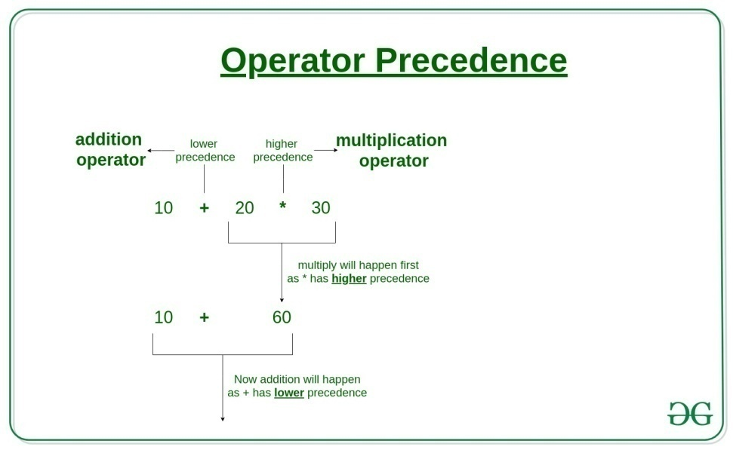
Precedence in Python operator
Operators | Meaning
() | Parentheses
** | Exponent
+x, -x, ~x | Unary plus, Unary minus, Bitwise NOT
*, /, //, % | Multiplication, Division, Floor division, Modulus
+, - | Addition, Subtraction
<<, >> | Bitwise shift operators
& | Bitwise AND
^ | Bitwise XOR
| | Bitwise OR
==, !=, >, >=, <, <=, is, is not, in, not in | Comparisons, Identity, Membership operators
not | Logical NOT
and | Logical AND
or | Logical OR
The operator precedence in Python is listed in the following table. It is in descending order (upper group has higher precedence than the lower ones).

Slide 14
Associativity of python operators
When two operators have the same precedence, associativity helps to determine the order of operations.
Associativity is the order in which an expression is evaluated that has multiple operators of the same precedence. Almost all the operators have left-to-right associativity.
For example, multiplication and floor division have the same precedence. Hence, if both of them are present in an expression, the left one is evaluated first.
Example:
# Left-right associativity
# Output: 3
print(5 * 2 // 3)
# Shows left-right associativity
# Output: 0
print(5 * (2 // 3))

Slide 15
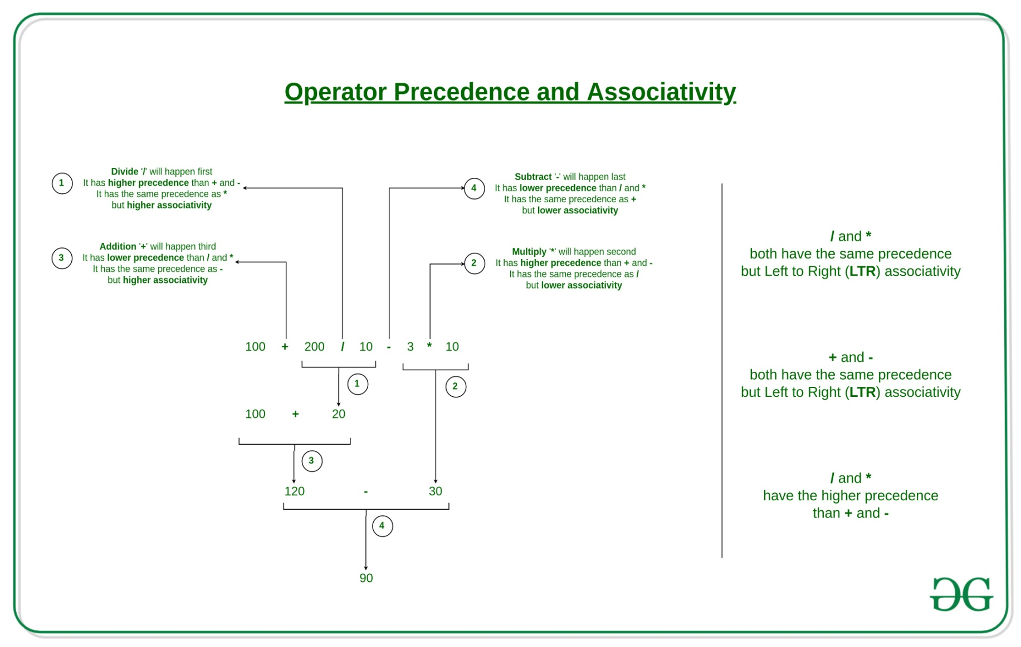
Associativity of python operators

Slide 16
Associativity of python operators
Exponent operator ** has right-to-left associativity in Python.
Example:
# Shows the right-left associativity of **
# Output: 512, Since 2**(3**2) = 2**9
print(2 ** 3 ** 2)
# If 2 needs to be exponated first, need to use ()
# Output: 64
print((2 ** 3) ** 2)
We can see that 2 ** 3 ** 2 is equivalent to 2 ** (3 ** 2).

Slide 17
Associativity of python operators
Operator | Description | Associativity
( ) | Parentheses | left-to-right
** | Exponent | right-to-left
* / // % | Multiplication/division/modulus | left-to-right
+ – | Addition/subtraction | left-to-right
<< >> | Bitwise shift left, Bitwise shift right | left-to-right
< <= > >= | Relational less than/less than or equal to Relational greater than/greater than or equal to | left-to-right
== != | Relational is equal to/is not equal to | left-to-right
is, is not in, not in | Identity Membership operators | left-to-right
& | Bitwise AND | left-to-right
^ | Bitwise exclusive OR | left-to-right
| | Bitwise inclusive OR | left-to-right

Slide 18
Associativity of python operators
Operator | Description | Associativity
not | Logical NOT | right-to-left
and | Logical AND | left-to-right
or | Logical OR | left-to-right
= += -= *= /= %= &= ^= |= <<= >>= | Assignment Addition/subtraction assignment Multiplication/division assignment Modulus/bitwise AND assignment Bitwise exclusive/inclusive OR assignment Bitwise shift left/right assignment | right-to-left

Slide 19
Non-Associative operators:
Some operators like assignment operators and comparison operators do not have associativity in Python.
There are separate rules for sequences of this kind of operator and cannot be expressed as associativity.
For example, x < y < z neither means (x < y) < z nor x < (y < z). x < y < z is equivalent to x < y and y < z, and is evaluated from left-to-right.
Furthermore, while chaining of assignments like x = y = z = 1 is perfectly valid, x = y = z+= 2 will result in error.

Slide 20
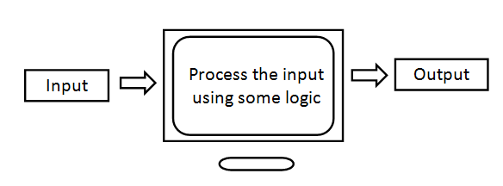
Input And Output
The purpose of a computer is to process data and return results. I
t means that first of all, we should provide data to the computer.
The data given to the computer is called input.
The results returned by the computer are called output.
So, we can say that a computer takes input, processes that input and produces the output, as shown in fig

Slide 21


Input And Output
To provide input to a computer, python provides some statements which are called Input statements. Similarly, to display the output, there are output statements available in python.
Output statements
The display output or results, python provides the print () function. This function can be used in different formats which are discussed here under.
The print () Statement
When the print() function is called simply. It will throw the cursor to the next line. It means that a blank line will be displayed.
The print (“string”) Statement
Please remember that in case of strings, double quotes and single quotes have the same meaning and hence can be used interchangeably.

Slide 22
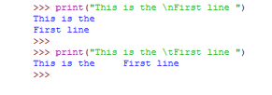
Output statements
We can use escape sequence characters inside the print () function. An escape sequence is a character that contains a special meaning.
For example, ‘\n’ indicates new line. ‘\t’ represents tab space.
To escape the effect of escape sequence, we should add one more ‘\’ (backslash) before the escape sequence character.
For example, \\ n displays ‘\n’ and \\t displays ‘\t’.

Slide 23


Output statements
We can use repetition operator (*) to repeat the strings in the output as:
The operator ‘+’ when used on numbers will perform addition operation. The same ‘+’ will not do addition operation on strings as it is not possible to perform arithmetic operations on strings.
When we use ‘+’ on strings, it will join one string with another string.
Hence ‘+’ is called concatenation (joining) operator when used on strings.
The ‘+’ operator in the preceding statement joined the two strings without any space in between. We can also write the preceding statement by separating the strings using ‘,’ as:

Slide 24


Output statements
The Print (variables list) Statement
We can also display the values of variables using the print () function.
A list of variables can be supplied to the print () function as:
Observe that the values in the output are separated by a space by default.
To separate the output with a comma, we should use ‘sep’ attribute as shown below.
‘sep’ represents separator. The format is sep=”characters” which are used to separate the values in the output.

Slide 25

Output statements
We can ask the print’ () function not to throw the cursor into the next line but display the output in the same line.
This is done using ‘end’ attribute. The way one can use it is end=”characters” which indicates the ending characters for the line. Suppose, we write end=”, then the ending character for each line will be “ (nothing) and hence it will display the next output in the same line.
If we use end=’\t’ then the output will be displayed in the same line but tab space will separate them as:
If we use end=’\n’ then the output will be displayed in the separate line. So, ‘\n’ is the default value for ‘end’ attribute.

Slide 26
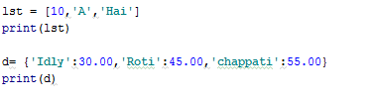


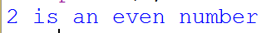
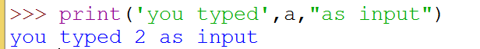
Output statements
The print (object) Statement
we can pass objects like lists, tuples or dictionaries to the print () function to display the elements of those objects.
The print (“string”, variable list) Statement
The most common use of the print () function is to use strings along with variables inside the print () function.

Slide 27


Output statements
The print (formatted string) Statement
The output displayed by the print () function can be formatted as we like. The special operator ‘%’ (percent) can be used for this purpose. It joins a string with a variable or value in the following format:
print (“formatted string” % (variables list))
in the formatted string we can use %i or %d to represent decimal integer numbers. We can use %f to represent float values. similarly we can use %s to represent strings.
When more than one variable is to be displayed, then parenthesis are needed as

Slide 28
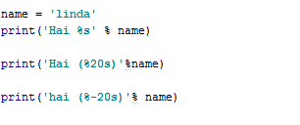


Output statements
To display a string, we can use %s in the formatted string.
When we use %20s, it will allot 20 spaces and the string is displayed right aligned in those spaces.
To align the strings towards left side in the spaces, we can use %-20s. consider the following examples.
We can use %c to display a single character as shown below:
The above example displayed 0th and 1st characters from name variable

Slide 29


Output statements
To display floating point values, we can use %f in the formatted string.
If we use %8.2f, then the float value is displayed in 8 spaces and within these spaces, a decimal point and next 2 fraction digits.
When we use %.3f, then the float value is displayed with 3 fraction digits after the decimal point. However the digits before decimal point will be displayed as they are.
Consider the following examples:

Slide 30

Output statements
Inside the formatted string, we can use replacement field which is denoted by a pair of curly braces { } .
we can mention names or indexes in these replacement fields.
These names or indexes represent the order of the values.
After the formatted string, we should write member operator and then format() method where we should mention the values to be displayed. Consider the general format given below:
print(‘format string with replacement fields’.format(values))
To display a single value using index in the replacement field, we can write as:

Slide 31
Input statements
To accept input from keyboard, python provides the input () functions.
This function takes a value from the keyboard and returns it as a string .for example.
str = input() #this will wait till we enter a string
Raj kumar # enter the string
print(str)
Raj Kumar
Once the value comes into the variable ‘str’, it can be converted into ‘int’ or ‘float’ etc. this is useful to accept number as:
Example 1:
str = input('enter a number:')
enter your name:rajkumar
x= int(str) #str is converted into int
print(x)
125
Example 2:
x=int(input('enter a number:'))
#enter a number: 125
print(x)
125

Slide 32
Input statements
Similarly ,to accept a float value from the keyboard, we can use the float() function along with the input() functions as:
x= float(input('enter a number:'))
enter a number: 12.345
print(x)
12.345
A python program to accept two numbers and find their sum.
#find sum of two numbers
x= int(input('enter first number: '))
y= int(input('enter second number: '))
print('the sum of ',x,'and', y, 'is', x+y) #display sum
print('the sum of {}and {} is {}'.format(x,y, x+y))#display again
Output:
enter first number:88
enter second number: 98
the sum of 88 and 98 is 186
the sum of 88 and 98 is 186

Slide 33
Command Line Arguments
We can design our programs in such a way that we can pass inputs to the program when we give run command.
For example, we write a program by the name ‘add.py’ that takes two numbers as input to the program at the time of running the program at command prompt as:
C:\>python add.py 10 22
Sum = 22
Here, add.py is our python program name, while running this program, we are passing two arguments 10 and 22 to the program, which are called command line arguments.
Command line arguments are passed to the program from outside the program.
All the arguments should be entered from the keyboard separating them by a space.
These arguments are stored by default in the form of strings in a list with the name ‘argv’ which is available in sys module.
Since argv is a list that contains all the values passed to the program, argv[0] represents the name of the program, argv[1] represents the first value, argv[2] represents the second value and so on, as shown
argv[0]= add.py argv[1]= 10 argv[2]= 22

Slide 34
Command Line Arguments
If we want to find the number of command line arguments, we can use the len() function as: len(argv).
The following program reads the command line arguments entered at command prompt and displays them.
A python program to display command line arguments.
# to display command line args. Save this as cmd.py.
import sys
n = len (sys.argv) #n is the number of arguments
args = sys.argv # args lists contains arguments
print('No.of command line args=', n)
print ('The args are: ', args)
print('The args one by one: ')
for a in args:
print(a)
Output:
c:\python cmd.py 10 Aishwarya Shetty 22500.75
No.of command line args= 5
The args are: ['cmd.py', '10','Aishwarya',‘Shetty','22500.75']
The args one by one:
cmd.py
10
Aishwarya
Shetty
22500.75

Slide 35
Command Line Arguments
A python program to find sum of two numbers using command line arguments.
# to add two numbers. Save this as add.py
import sys
#covert args into integers and add them
sum = int (sys.argv [1]) +int (sys.argv [2])
print ('sum= ', sum)
Output:
c:\python add.py 10 22
sum= 22

Slide 36

www.mallareddyuniversity.ac.in
Notes:
You can safely remove this slide. This slide design was provided by SlideModel.com – You can download more templates, shapes and elements for PowerPoint from http://slidemodel.com

